Slide 1

Insurance Analytics
Rohit Tedlapu
Babitha Kudikala
Nitish Kusalkar
Bokka Hemanth Venkata Ayyan kumara swamy
Mukesh kailas jagtap

Slide 2
Summary
The report we have generated using data cleaning, data exploration and manipulation.
The 3 Categories Cross Sell, New and Renewal have achieved the target but coming to the ‘New’ the invoice amount is very low compared to others.
Account Executive ‘Abhinav Shivam’ have the highest meeting count from 2019 to 2020.
The Yearly meeting count, In 2019 there are 3 account executives and in 2020 there are 31 account executives.
Account Executive ‘Divya Dhingra’ have the highest Renewal count compared to other account executives.
The report we have created shows the Top Open Opportunities and the Top Account Executives which are very important to increase the Revenue.

Slide 3
KPI’s
Number of Invoice by Account Executive
Yearly Meeting Count
Target, Achieve, Invoice -
Cross Sell
New
Renewal
Stage Funnel by Revenue
Number of meeting By Account Executive
Top Open Opportunity

Slide 4
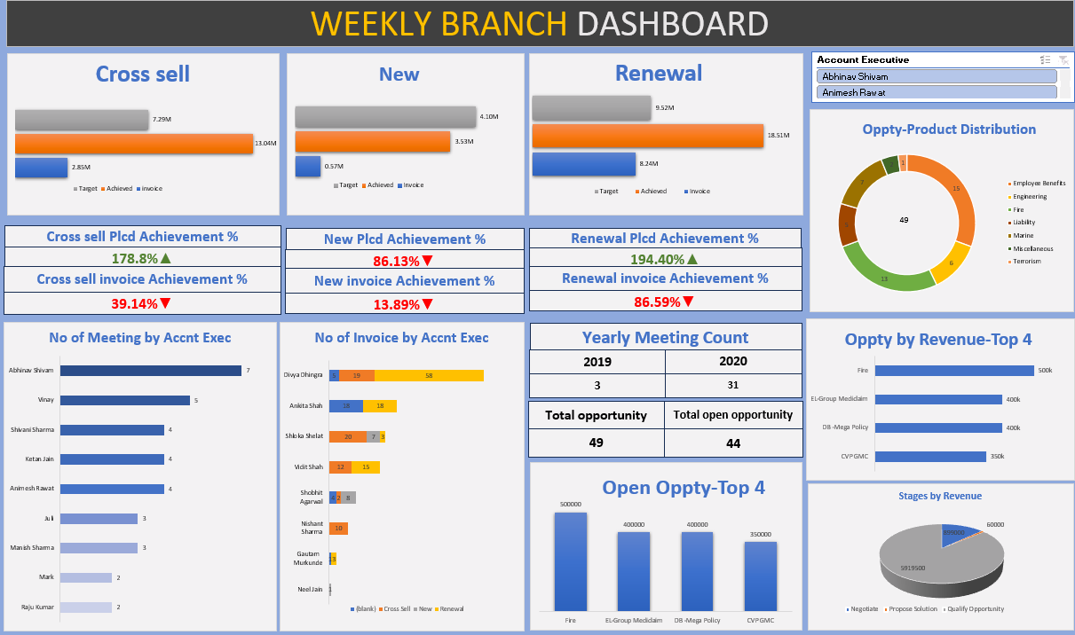
EXCEL DASHBOARD

Slide 5
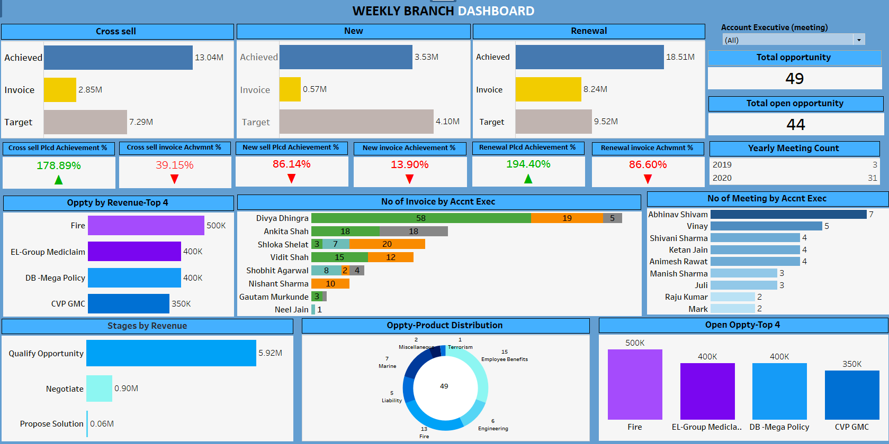
Tableau DASHBOARD

Slide 6
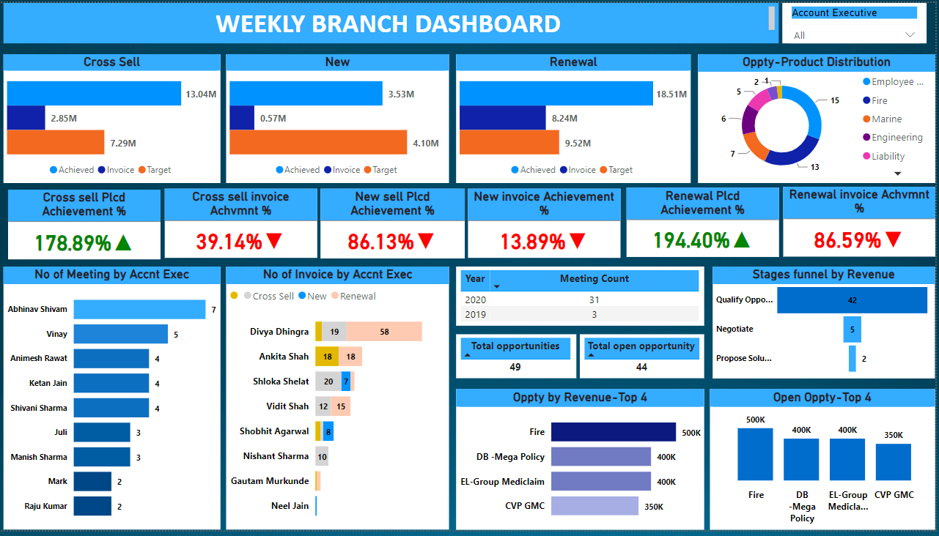
Power BI DASHBOARD

Slide 7
Key Take Aways
We have learned the how to import the data to the My sql.
we also have learned how to connect to different servers and how to work on the excel , powerbi and tableau and how to work on the excel , power Bi and tableau.
The Top 4 Open Opportunities making more revenue by the Account Executives.
The Category ‘New’ Revenue must be increased because as compared to Cross Sell and Renewal. ‘New’ is lacking very much in terms of invoice.
Number of meeting By Account Executive - ‘Abhinav Shivam’ have the highest meeting count.
The company must focus on creative marketing levels by the Account Executives to make more opportunities.

